Slide 1


Evaluation methodology
Induction training
Zagreb-Ancona, 11 July 2022
Paul Georis

Slide 2
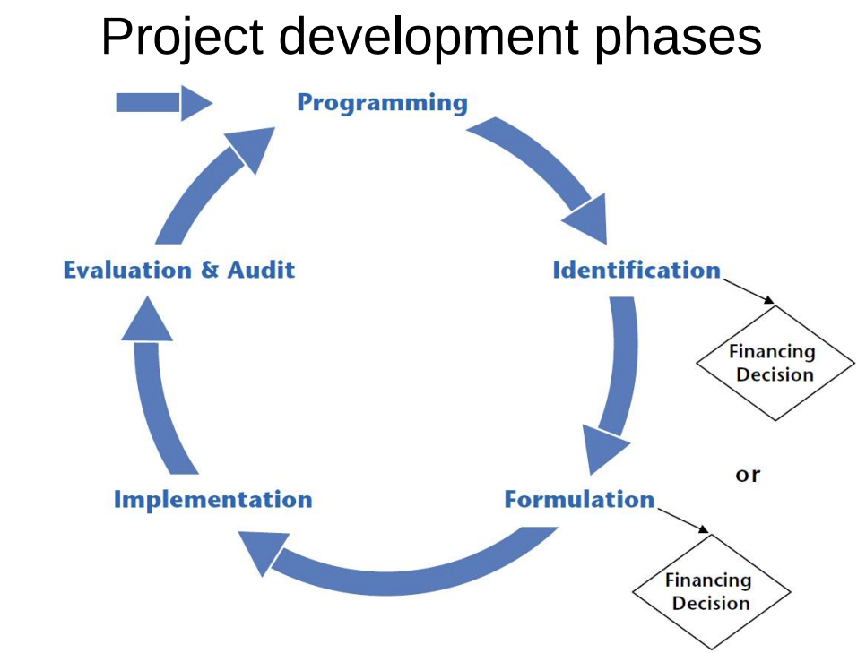
Why evaluate?
Integral part of PCM; by providing evidence of what works and what doesn’t (and under which circumstances):
Improves the way how to engage with partners and stakeholders (political and policy dialogue)
Enhances the impact of programmes/projects (learning process)
Informs programming of subsequent interventions
Enhances visibility of results

Slide 3
Types of evaluation
Project
Programme
Ex ante
Mid-term
Ex post

Slide 4
Actors
Evaluation Team
Contracting Authority (client)
Evaluation Manager
Contractor
Stakeholders (programme recipients and beneficiaries)
Reference Group

Slide 5
Evaluation phases
Bidding
Inception
Desk
Field
Synthesis
Dissemination

Slide 6
Bidding
Methodology and financial offer in reply to terms of reference.
Inception
Reconstruction of intervention logic
Evaluation matrix (EQ, judgement criteria, indicators)
Team mobilisation, data collection and compilation
Sampling (case studies, countries, interviews)
Main output: Inception report, incl. detailed methodology and workplan
Meetings with reference group which validates the IR

Slide 7
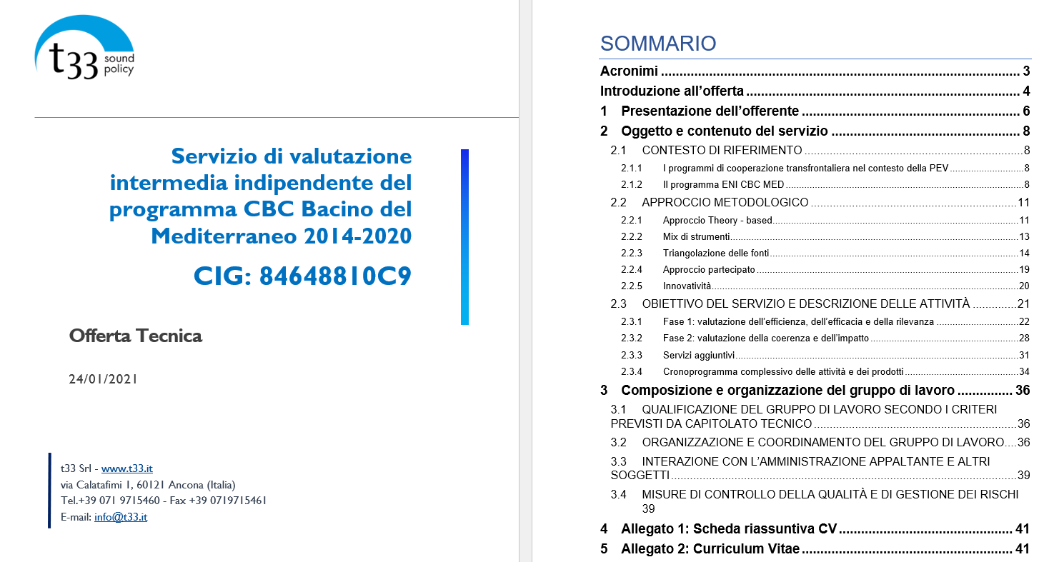
Bidding

Slide 8
Desk phase
Documentation review (action plans, contracts, progress and final reports, deliverables, M&E reports, etc.)
Data analysis and surveys
Preliminary answers to evaluation questions (EQs) + assumptions/hypotheses
Field phase methodology and plan
Main output: desk report validated by reference group

Slide 9
Field phase
Interviews of stakeholders
Data collection in situ, testing hypotheses
Reporting
Debriefing
Synthesis and dissemination phases
Finalisation of case studies
Triangulation
Final replies to evaluation questions (findings)
Conclusions and recommendations
Final Report validated by reference group
Final Conference + communication materials (dissemination)

Slide 10
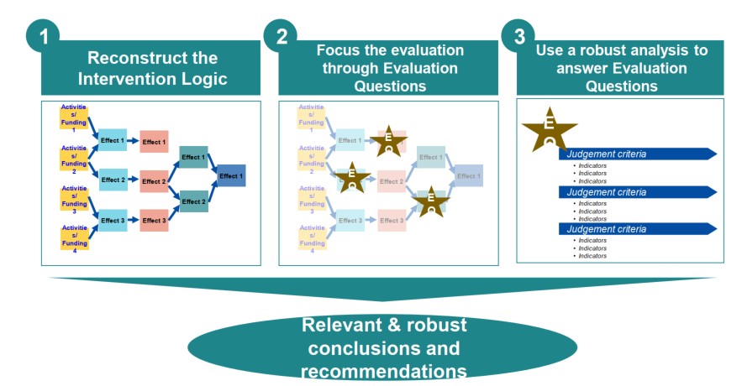
Evaluation process

Slide 11
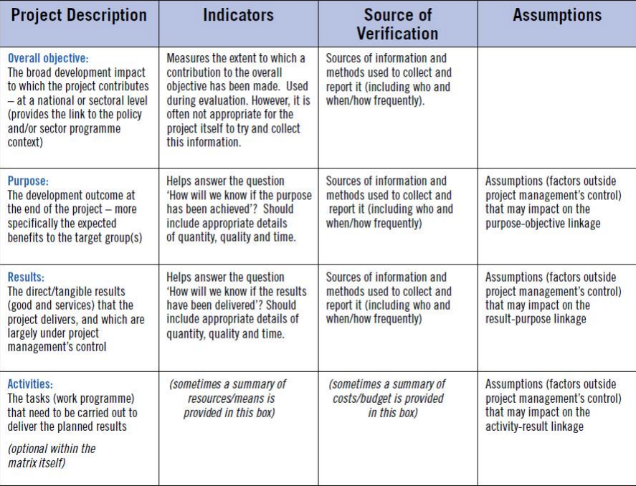
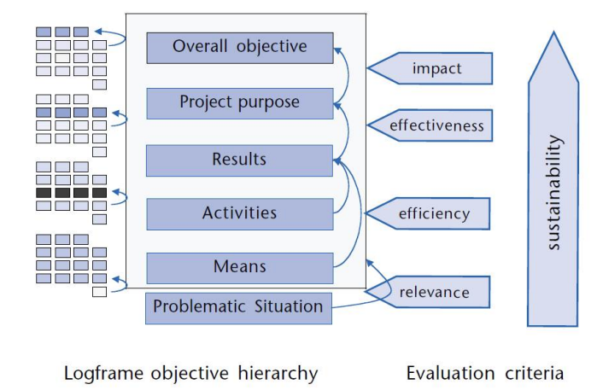
Link to logical framework

Slide 12
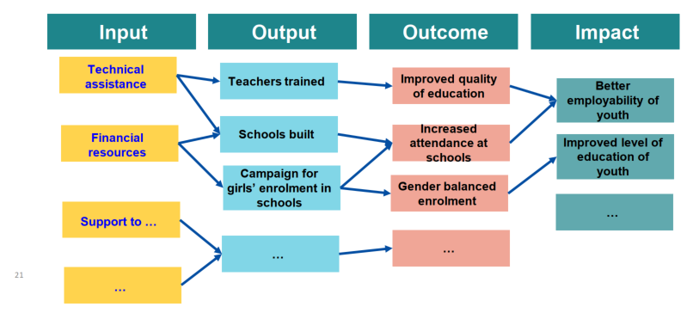
Reconstructed intervention logic
Definition: presentation of all activities and expected results and cause and-effect targeted relations in the context of the intervention
Aim: clarify objectives by ordering expected effects in a structured/hierarchic way and analysing/assessing the coherence of the intervention

Slide 13
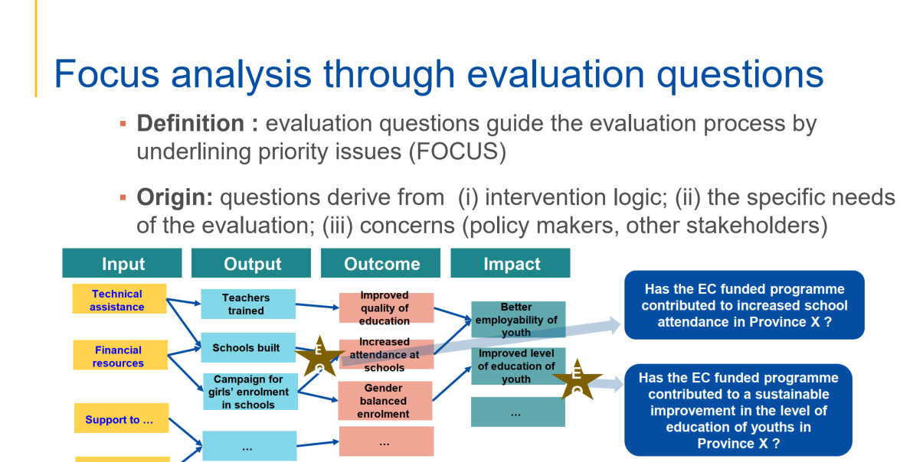

Slide 14
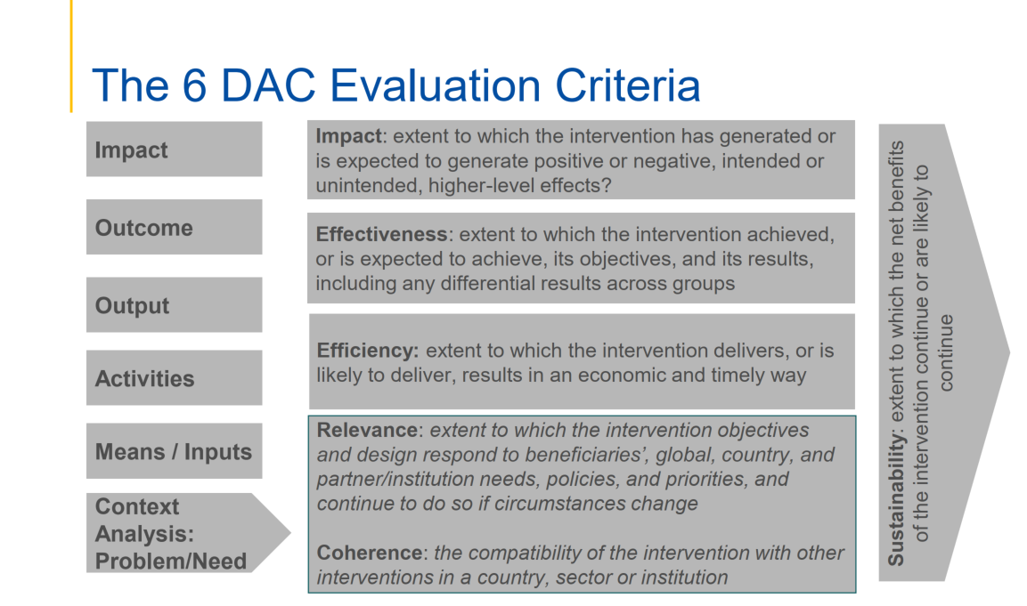

Slide 15
Relevance
Is the intervention doing the right things?
The extent to which the intervention’s objectives and design respond to beneficiaries’ global, country and partner/institution needs, policies and priorities, and continue to do so if circumstances change.
The definition of relevance comprises four main dimensions:
  responding to needs, policies and priorities;
  being sensitive and responsive to context;
  quality of design;
  responsiveness over time.

Slide 16
Coherence
How well does the intervention fit?
The compatibility of the intervention with other interventions in a country, sector or institution.
  Internal coherence: alignment with the wider policy frameworks of the institutions; with other interventions implemented by the institution including those of other departments or interventions which may affect the context.
  External coherence: alignment with external policy commitments (e.g. SDGs); and coherence with interventions implemented by other actors in a specific context.

Slide 17
Effectiveness
Is the intervention achieving its objectives?
The extent to which the intervention achieved, or is expected to achieve, its objectives and its results, including any differential results across groups.
Includes the key concepts of: achievement of objectives, the varying importance of objectives and results, differential results across groups and understanding the factors that influence outcomes.

Slide 18
Efficiency
How well are resources being used?
The extent to which the intervention delivers, or is likely to deliver, results in an economic and timely way.
Evaluating efficiency involves looking at the key areas of economic efficiency, operational efficiency, and timeliness.

Slide 19
Impact
What difference does the intervention make?
The extent to which the intervention has generated or is expected to generate significant positive or negative, intended or unintended, higher-level effects.
Includes the key concepts of higher-level effects, significance, differential impacts, unintended effects and transformational change.

Slide 20
Sustainability
Will the benefits last?
The extent to which the net benefits of the intervention continue or are likely to continue.
Involves understanding the components of the enabling environment, the continuation of positive effects, and risks and trade-offs.

Slide 21
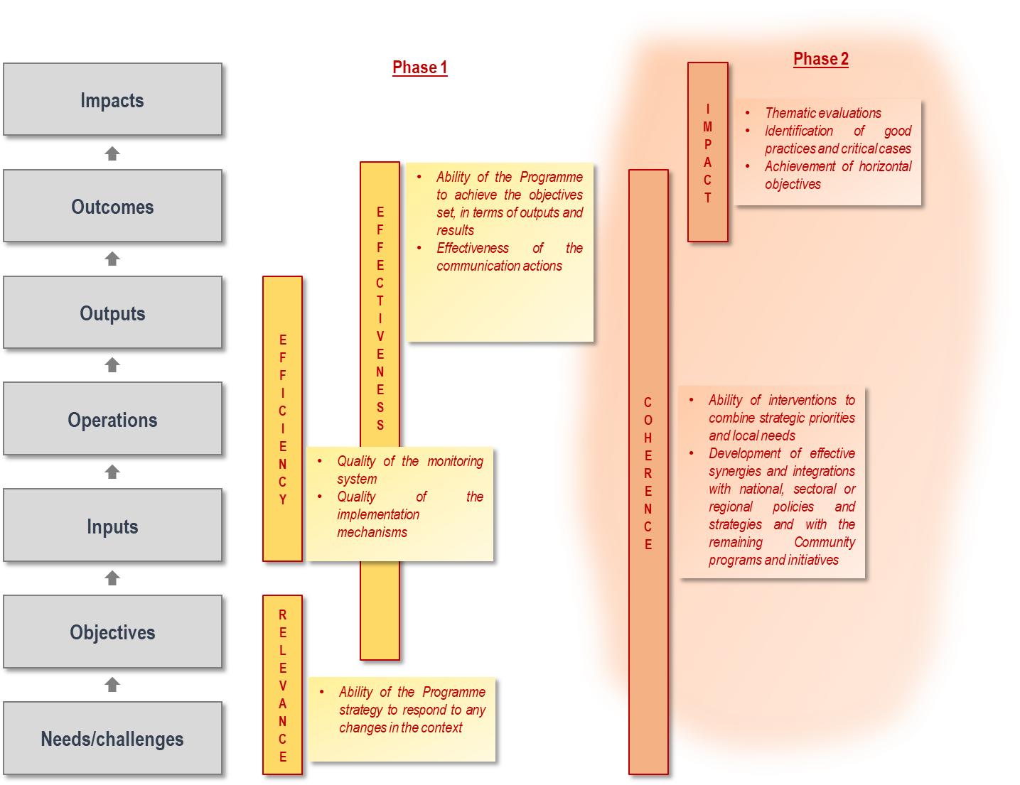
ENI CBC MED evaluation

Slide 22

Evaluation questions
EQ are related to a specific evaluation criterion (usually one question per criterion but can be more)
Each EQ breaks down into several judgment criteria (JC) i.e. a statement which guides the evaluation team on how to answer the EQ after having collected and analysed all relevant data
Each JC must be assessed by means of a few indicators (quantitative or qualitative)

Slide 23
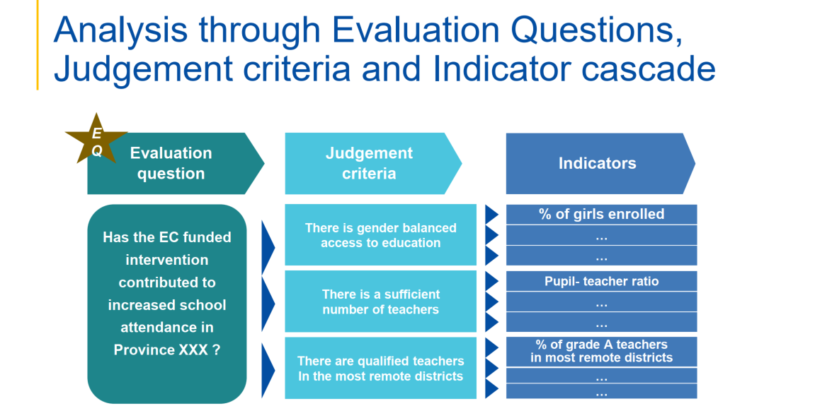

Slide 24
Evaluation matrix
EQ1
JC1.1
Ind 1.1.1
JC1.2
Ind 1.2.1
Ind 1.2.2
Ind 1.1.2
EQ 2
JC 2.1
Ind 1.1
Ind 1.2
JC …
Ind …
Ind …
EQ 7
JC …
Ind …
Ind …
JC …
Ind …
Ind …
JC 2.4
Ind 2.4.1
Ind 2.4.2
…

Slide 25
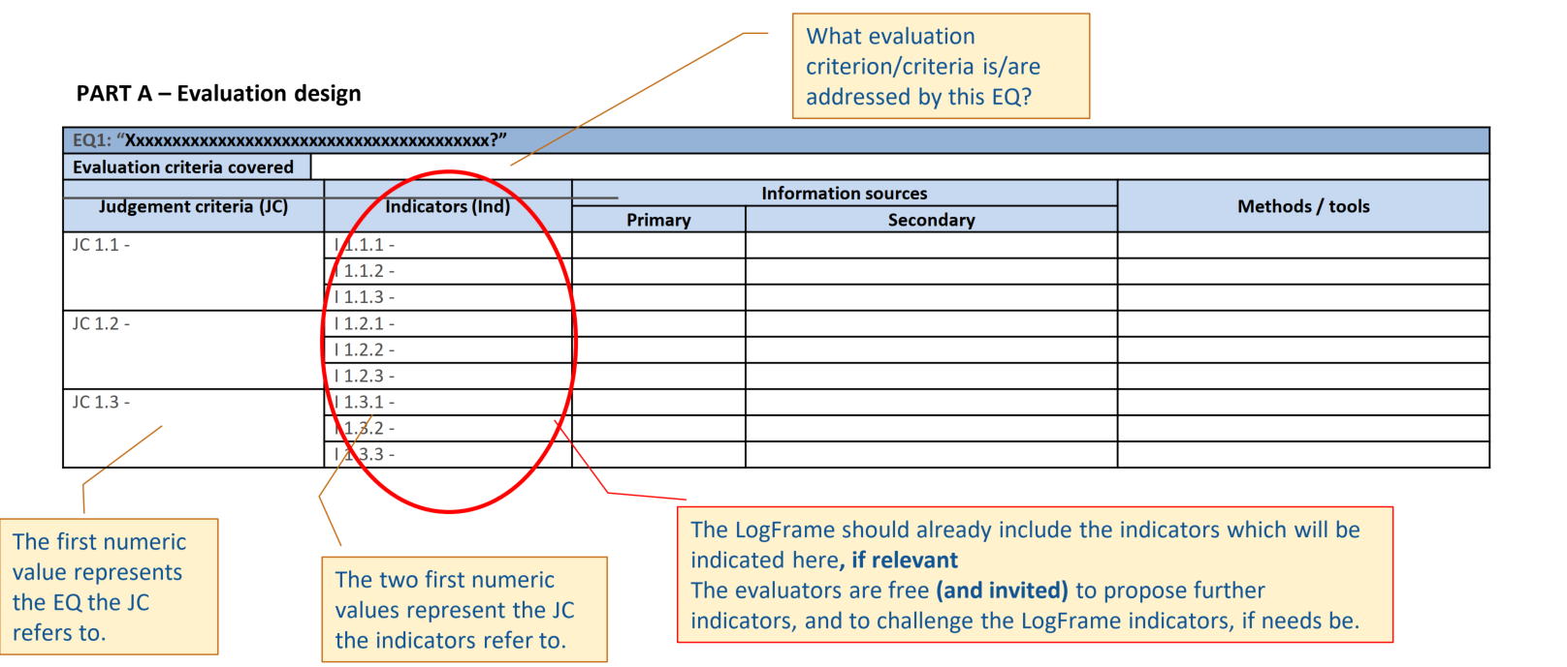
Evaluation matrix

Slide 26
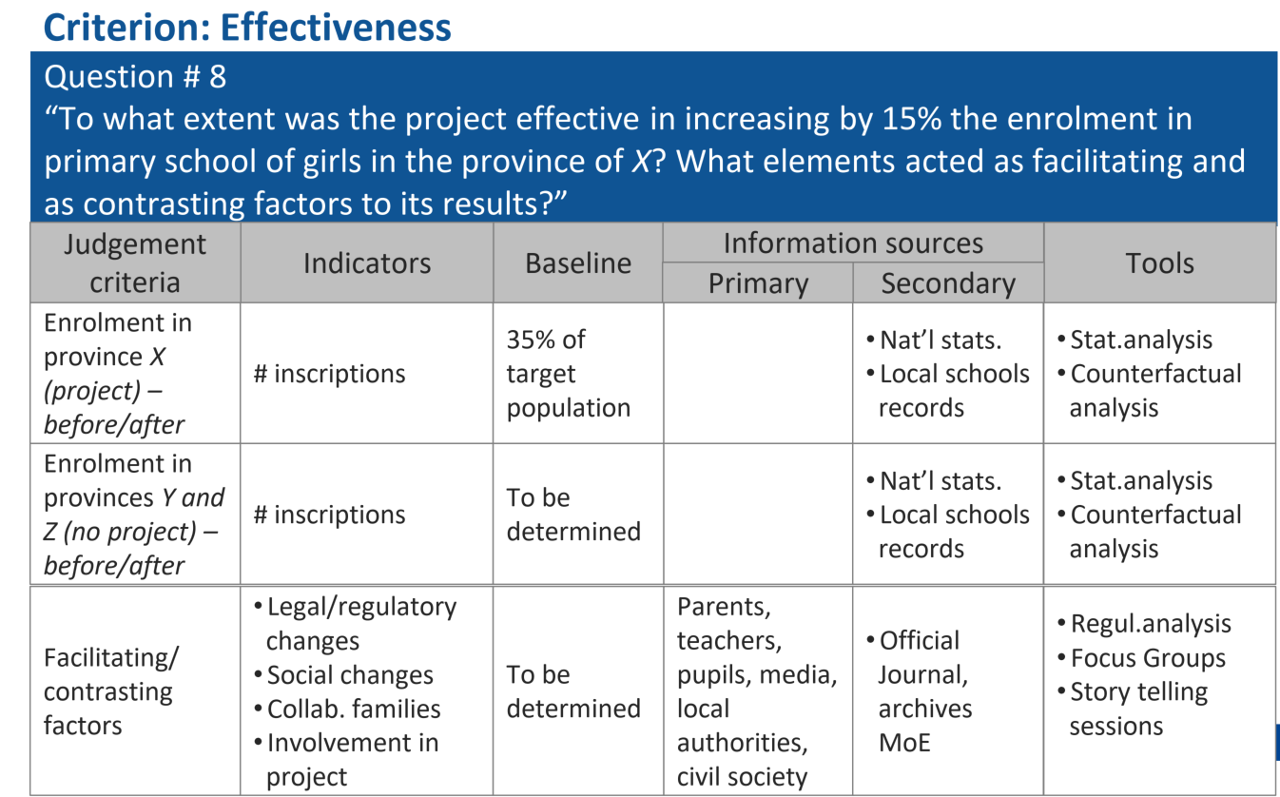
Evaluation question

Slide 27

Evaluation methods and tools
Interviews
Surveys
Focus groups
Case studies
Statitistical analysis (quantitative data)

Slide 28
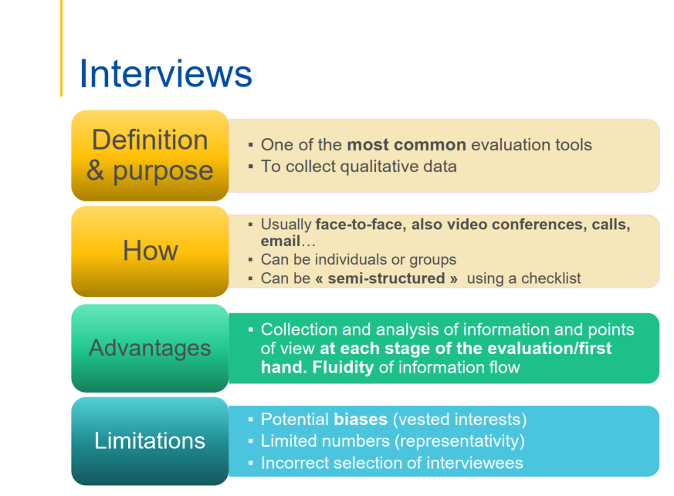

Slide 29
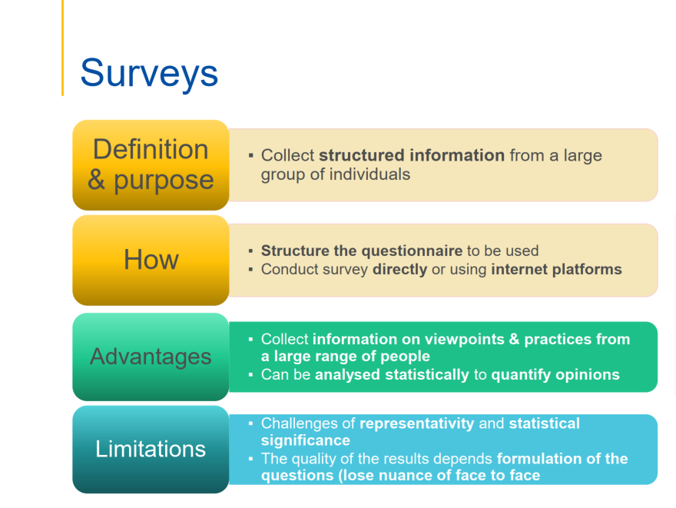

Slide 30
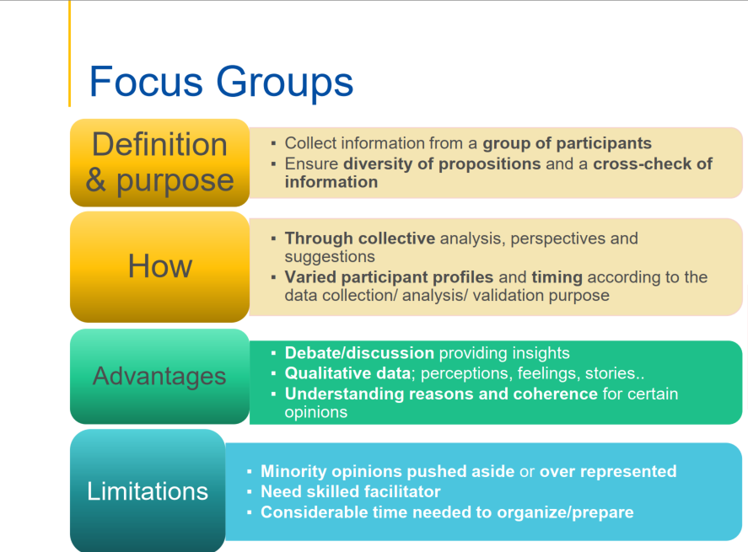

Slide 31
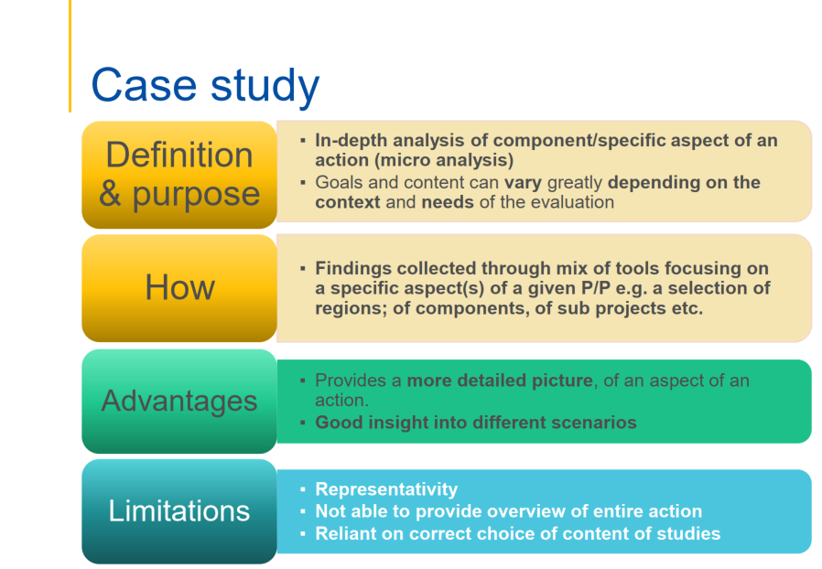

Slide 32
Statistical analysis
Used to investigate things that can be measured or quantified to generate numerical data
Measure the amount of things and their relationships
Provide uniform measures of project achievements (all along the results chain)
Usually aim to tell us something about a target group/activity (findings can/should be generalised)
Popular with many because of their potential to generalize results
Often takes less time to administer quanti than quali methods
Make large use of secondary data sources

Slide 33
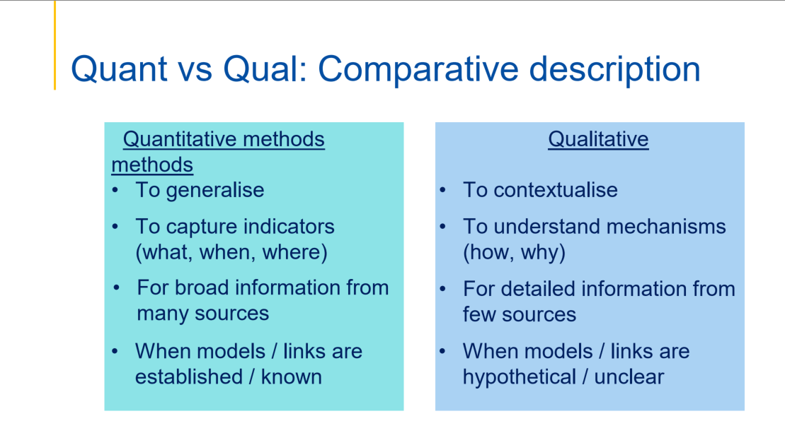

Slide 34

Life is short, and art long, opportunity fleeting, experimentation perilous, and judgment difficult.
Hippocrates

Slide 35
ANY QUESTIONS?

