Slide 1

FIRENZE 25 October 2021
Financial Instruments and Cohesion policy
Alessandro Valenza
a.valenza@t33.it

Slide 2
What are we going to talk today?
What is a financial instrument
Different types of financial instruments (products)
The life cycle of a financial instruments
Why using financial instruments in Cohesion Policy
Work-out
CREDIT / DISCLAIMER
The following slides of this presentation are taken form the official presentations/ publications of fi-compass (https://www.fi-compass.eu): 11, 12, 13, 14, 16, 19-29, 32)

Slide 3
What is a financial instrument

Slide 4
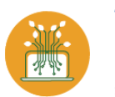
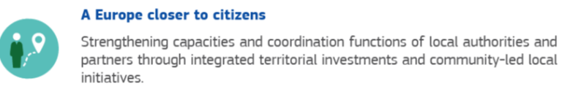
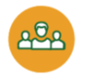
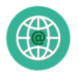

Delivering cohesion policy
Program
Grants
Selection of financial intermediary
Call for proposal
Target group
Financial Instrument
Public Procurement
Call for tender
SERVICES GOODS

Slide 5
Delivering cohesion policy
Program
Grants
Selection of financial intermediary
Call for proposal
Target group
Financial Instrument
Public Procurement
Call for tender

Slide 6
What is a financial instrument?
PROCUREMENT
CONTRACT AUTHORITY
GRANT
DONOR
FINANCIAL
PROVIDER
beneficiary

Slide 7
What is a financial instrument?
LENDER
( Guarantor / Equity manager)
REPAYMENT
(final)
RECIPIENT

Slide 8
2) Different types of financial instruments (products)

Slide 9

TWO PRODUCT FAMILIES
OWNERSHIP
Loans
Private equity
Guarantees
Venture capital
FIXED REWARD

Slide 10




DIFFERRENCE PUBLIC/PRIVATE
 | LOWER INTEREST RATE
 | NO/ LIGHTER COLLATERALS
 | MERCY PERIOD
 | NO FINANCIAL ASSISTANCE

Slide 11
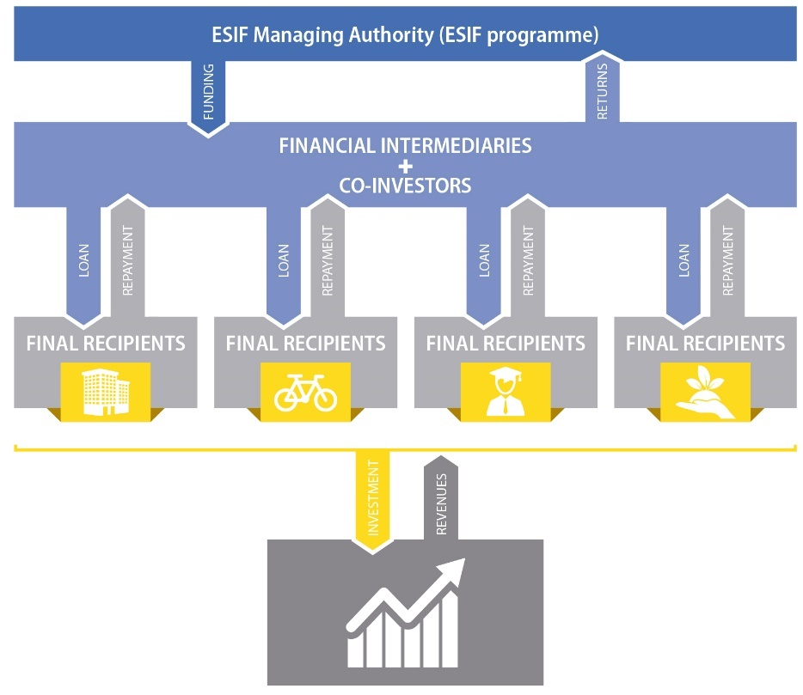
LOAN

Slide 12
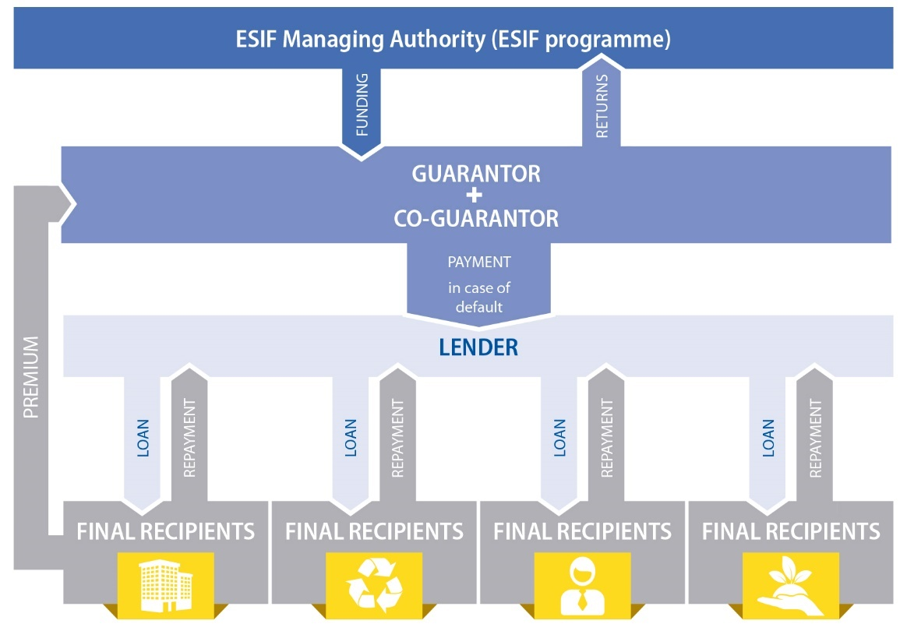
Guarantee

Slide 13
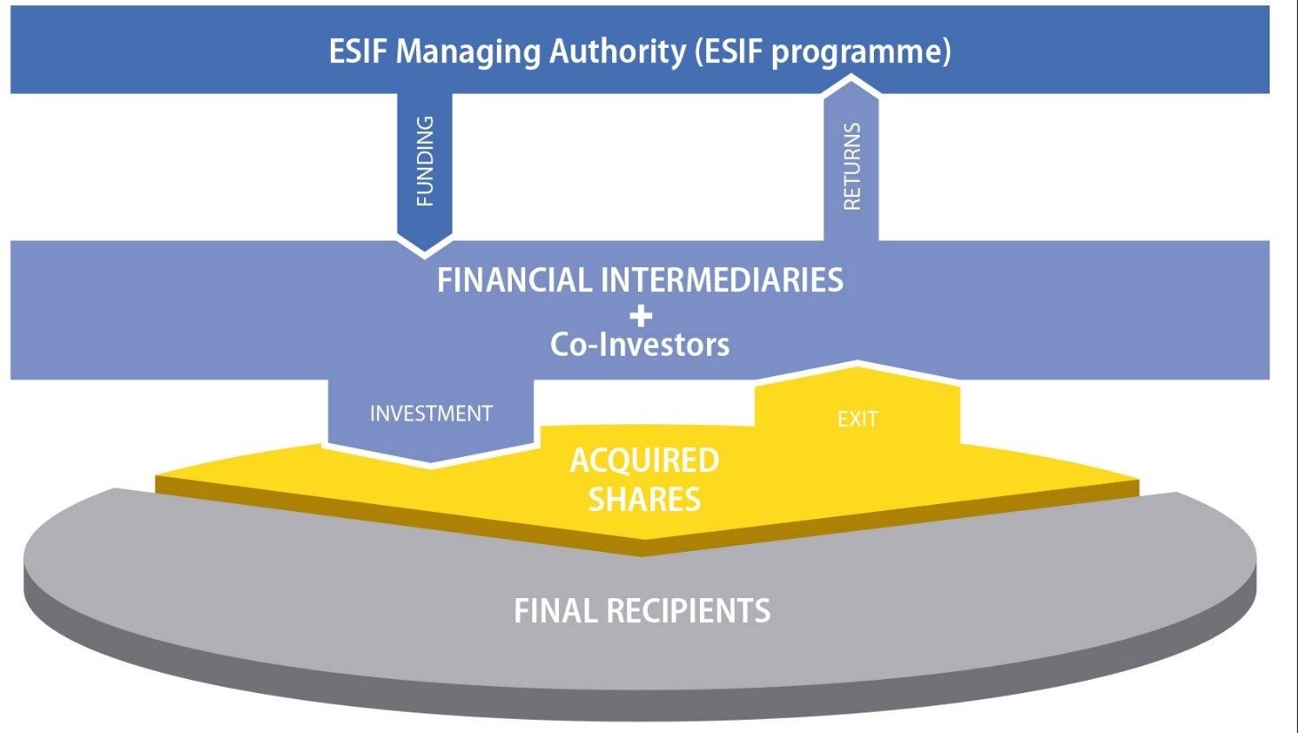
Equity

Slide 14
MICROFINANCE
Microfinance is the provision of basic financial services and products such as microcredit, micro‑savings, micro‑insurance and micro‑leasing.
Microfinance is particularly relevant to support microenterprises as well as low income and other disadvantaged people who have been excluded from access to traditional banking.
Self‑employment through small scale entrepreneurship supported by microcredit can address employment challenges.
https://www.fi-compass.eu/publication/brochures/factsheet-financial-instruments-working-microfinance

Slide 15
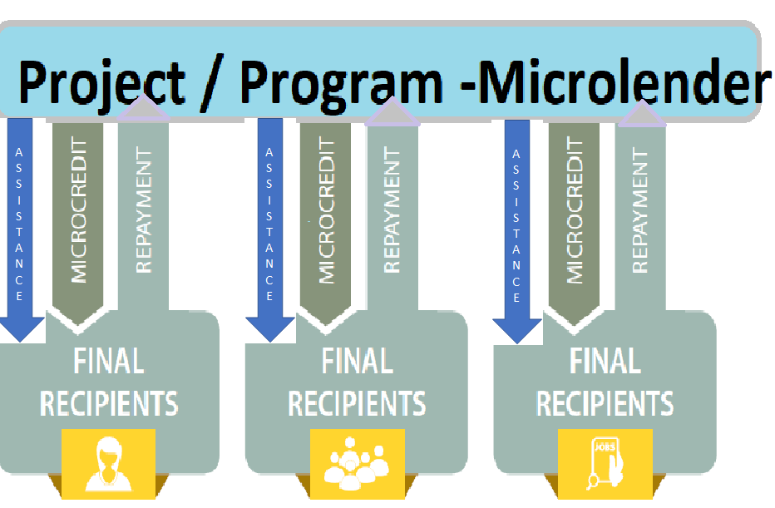
HOW DOES IT WORK

Slide 16
3) The life cycle of a financial instrument

Slide 17
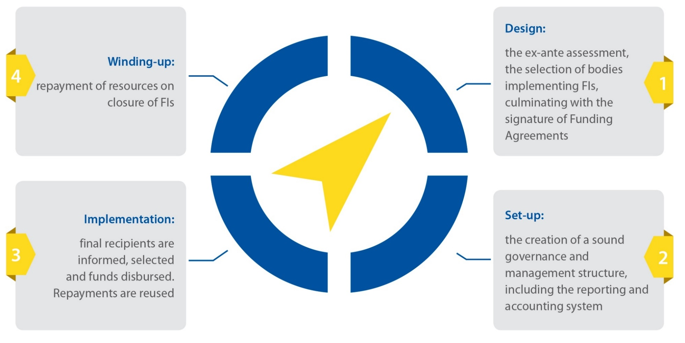
THE LIFE CYCLE

Slide 18
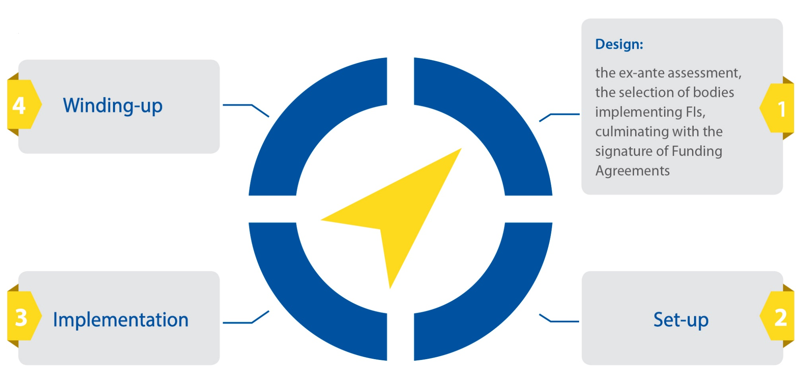
THE DESIGN PHASE

Slide 19
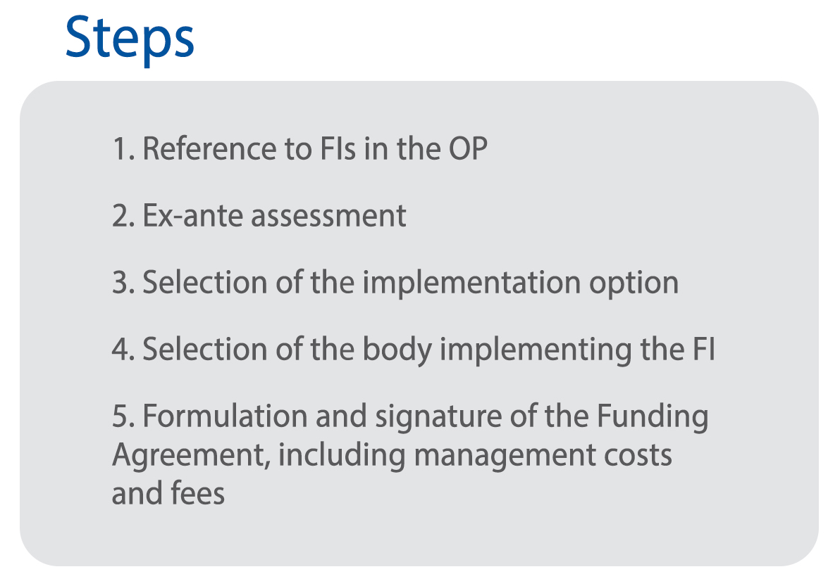
THE DESIGN PHASE

Slide 20
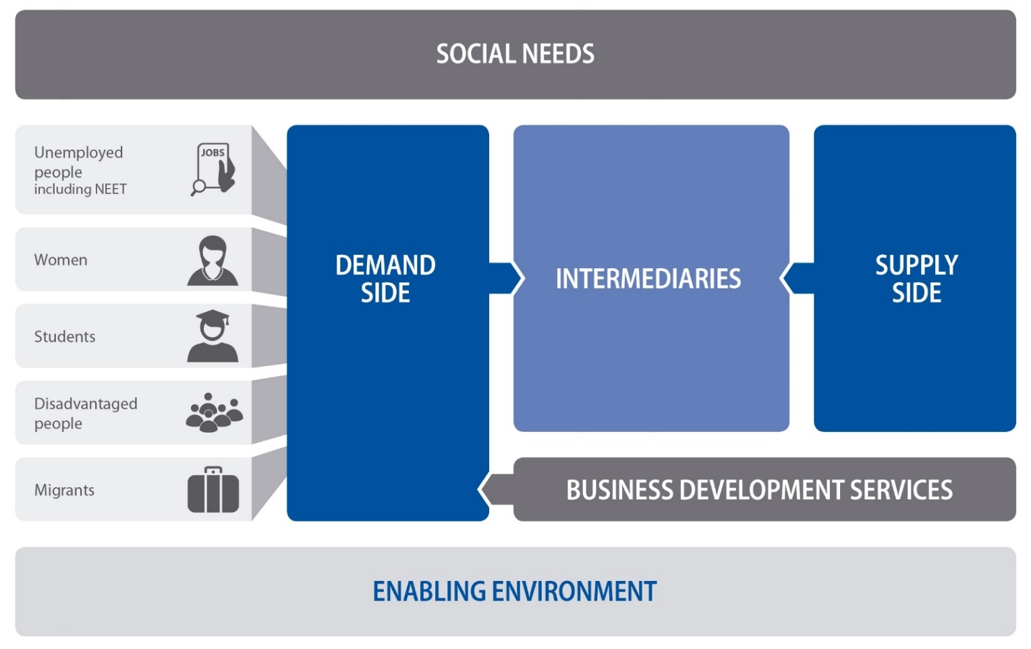
Considering the ECOSYSTEM

Slide 21
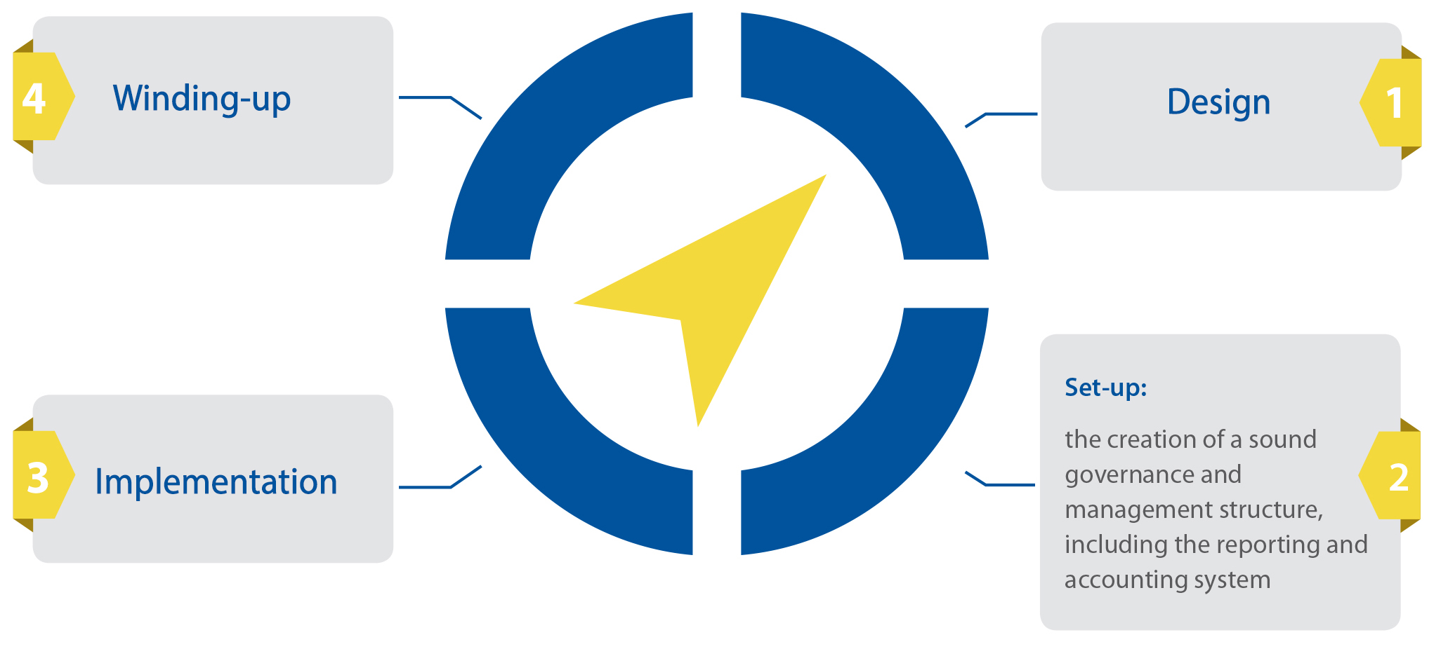
THE SET-UP PHASE

Slide 22
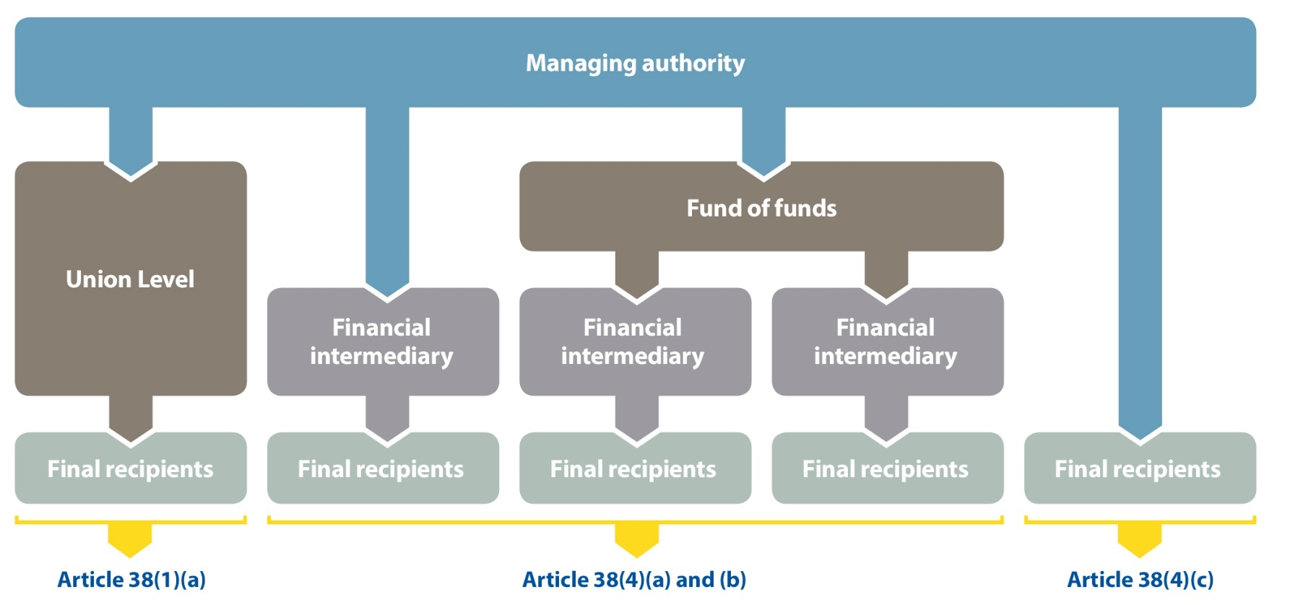
IMPLEMENTATION
OPTIONS AND GOVERNANCE

Slide 23
IMPLEMENTATION
OPTIONS AND GOVERNANCE

Slide 24
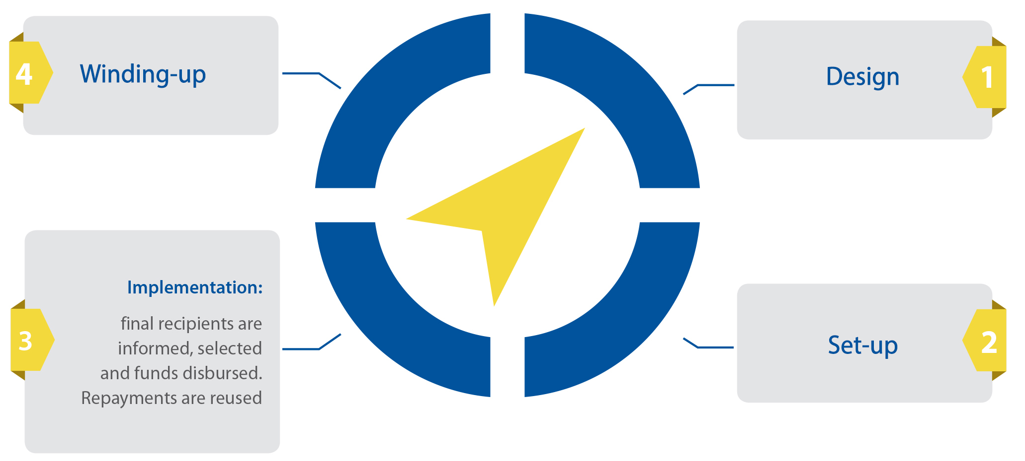
THE IMPLEMENTATION PHASE

Slide 25
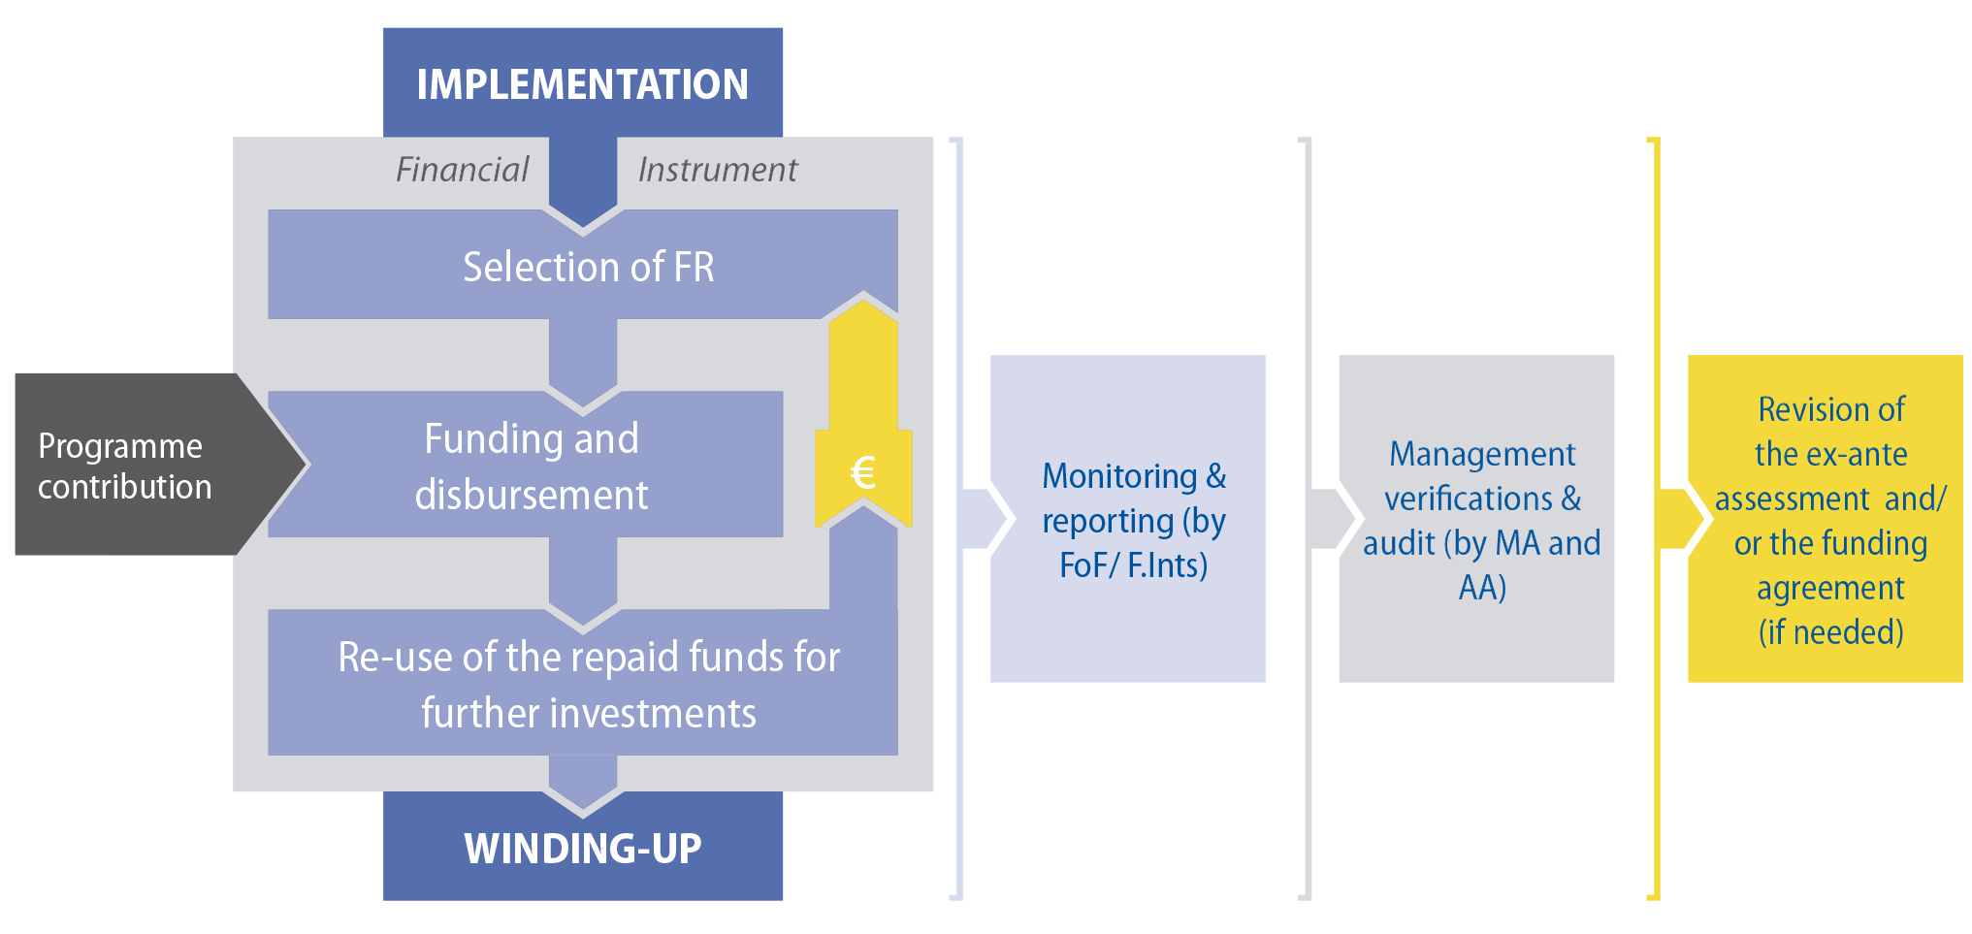
THE IMPLEMENTATION PHASE

Slide 26
4) Why using financial instruments in Cohesion Policy

Slide 27
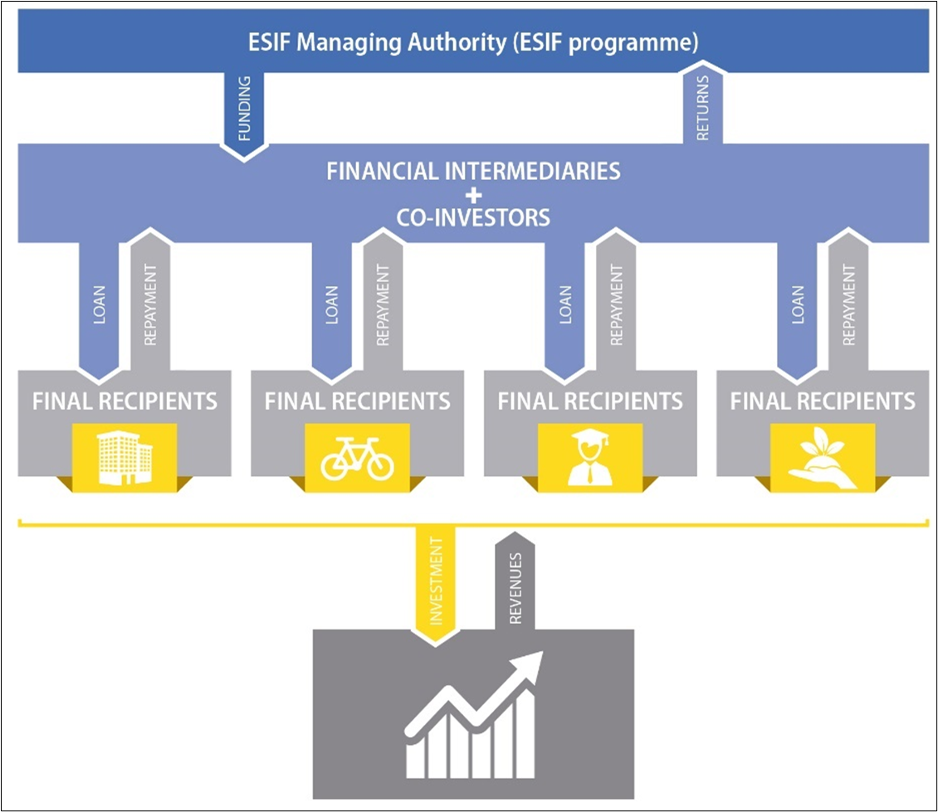
Leverage
Leverage

Slide 28
Revolving
Revolving

Slide 29




QUALITY OF PROJECTS
 | DISCIPLINE: TIMING AND DELIVERY OF THE PROJECT
 | FINACIAL CITIZENSHIP
 | SUSTAINIBILITY
 | ALLINGNEMENT OF INTEREST
Notes:
.

Slide 30





FLEXIBILITY
SMEs
and microenterprises
Large
(infrastructural projects)
Social needs

Slide 31
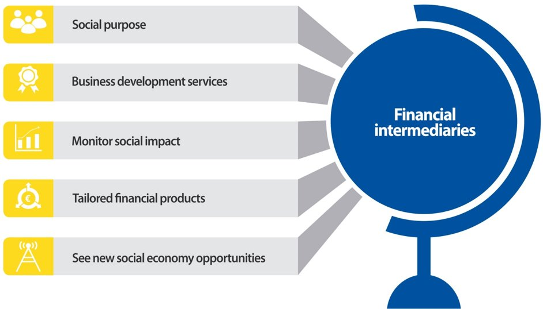
DEVELOPING THE ECOSYSTEM

Slide 32
WHY FINANCIAL INSTRUMENTS
Leverage effect: have the potential for ESF to lever in additional public and private contributions
Revolving nature: have the potential to be reused for further investments
Quality of the project: intrinsic discipline for the recipient
Can support a broad range of development objectives to the benefit of a wide range of target group (final recipients)
Beyond the target group: developing the ecosystem

Slide 33
KEY (IN)SUCCESS FACTORS
Should be market driven: importance of ex-ante assessment and of market tests
Alignment of interests: manging authority, fund-of-funds, financial intermediary, final recipient
Appropriate implementation arrangements and governance structures based on the internal capacity
Technical assistance (e.g. business development services) to prepare and support investments

